Slide 1

Tuberculosis
Lungs
Here is where our presentation begins

Slide 2
CONTENTS OF THIS Dataset :
Total of Images : 6336
Number of normal labels : 3500
Number of Tuberculosis labels : 2836

Slide 3
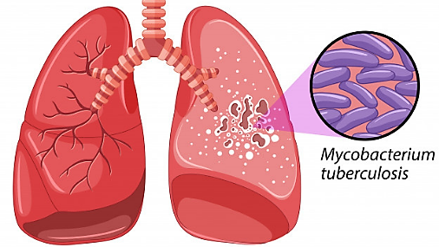
DEFINITION
Tuberculosis (TB) is a disease caused by germs that are spread from person to person through the air. TB usually affects the lungs, but it can also affect other parts of the body, such as the brain, the kidneys, or the spine. A person with TB can die if they do not get treatment.

Slide 4
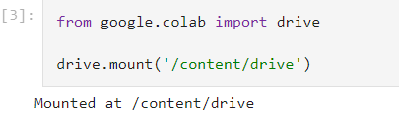
Getting The Dataset :

Slide 5
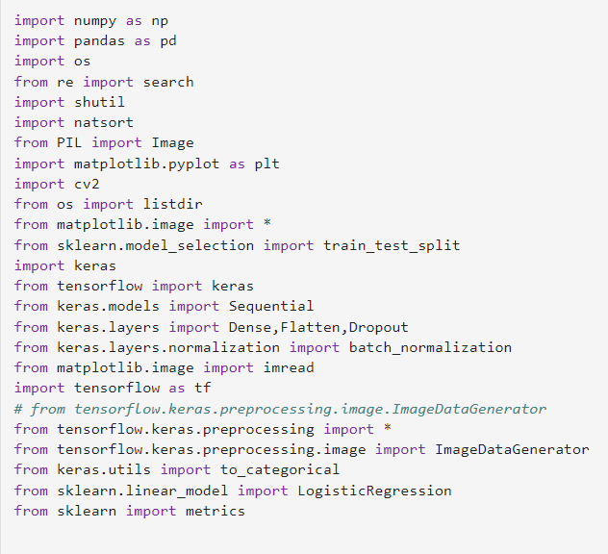
Libraries :

Slide 6
Preprocessing
The Dataset
01

Slide 7
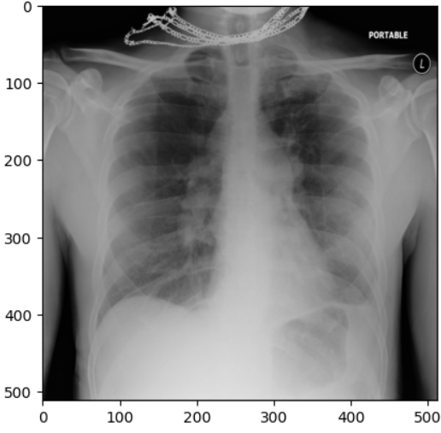
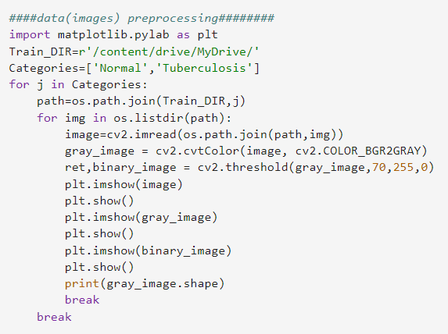
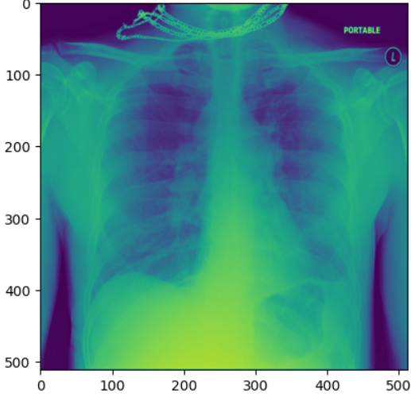
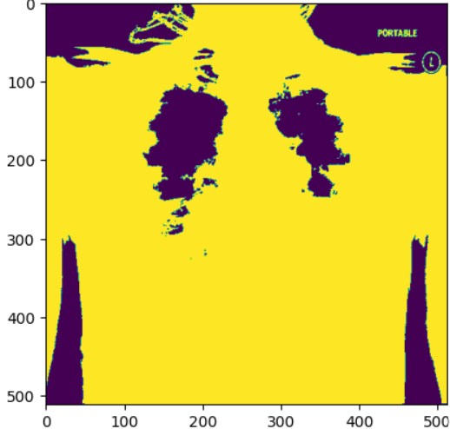
Image Preprocessing:

Slide 8
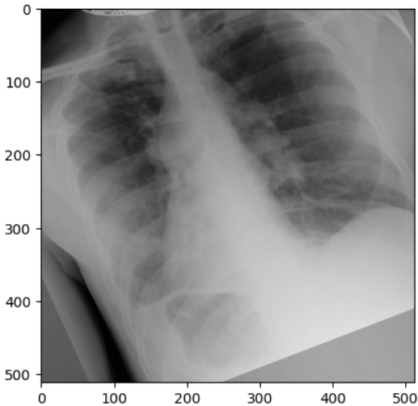
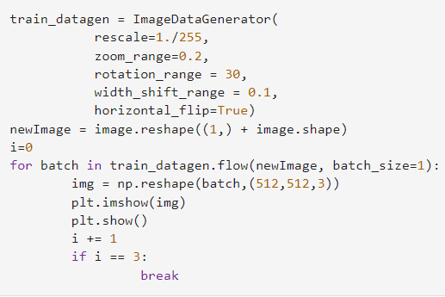
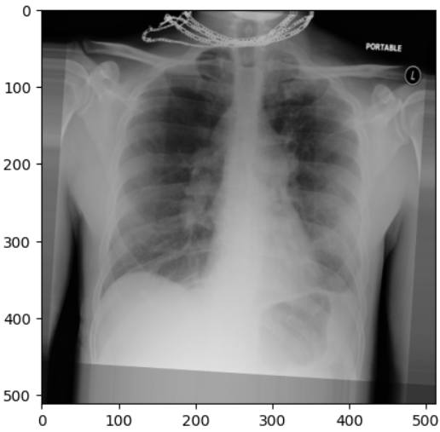
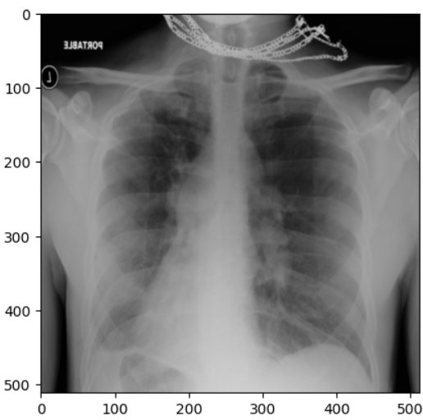
Balance The Number Of Images:

Slide 9
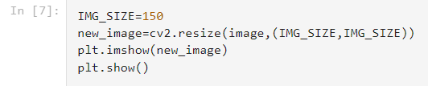

Resize The Image :

Slide 10
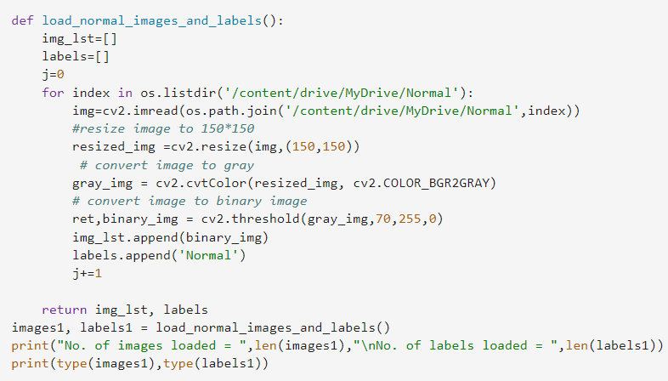

Loading Normal Images and Labels :

Slide 11
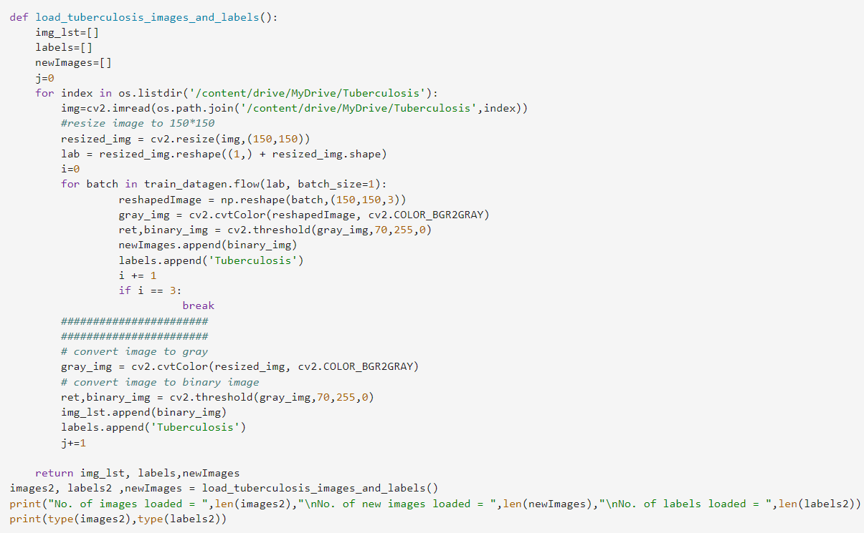

Loading Tuberculosis Images and Labels :

Slide 12
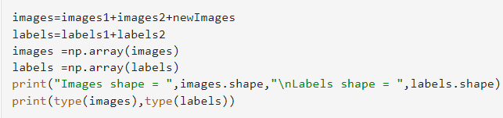

Loading Normal Images and Labels :

Slide 13
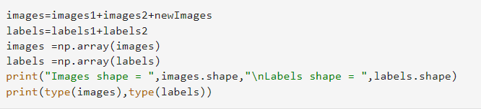

Collecting Images In one List :

Slide 14
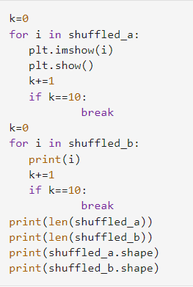
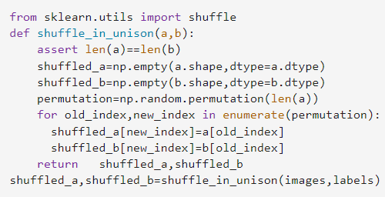
Shuffling The Dataset :

Slide 15
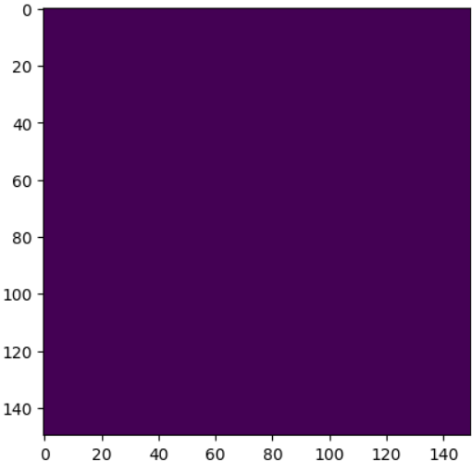
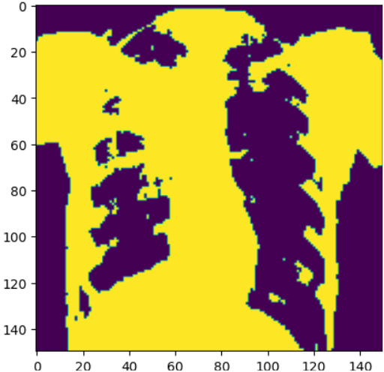
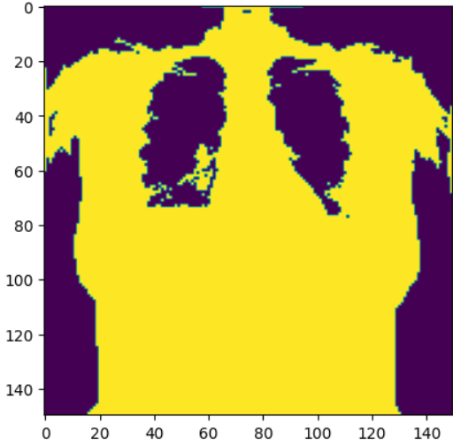
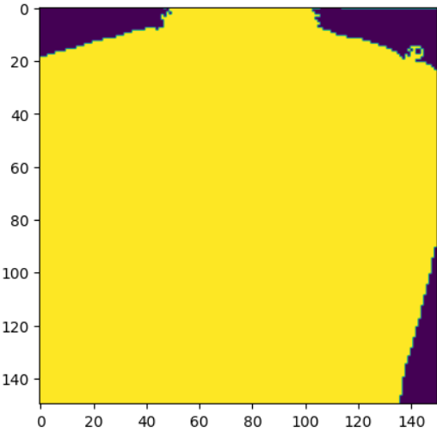
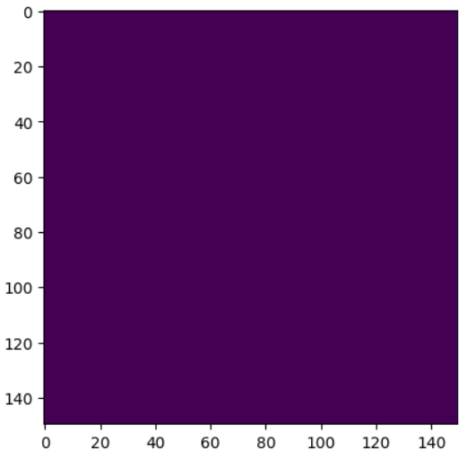
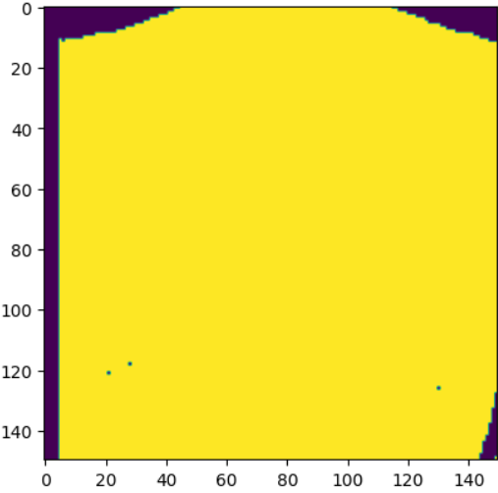
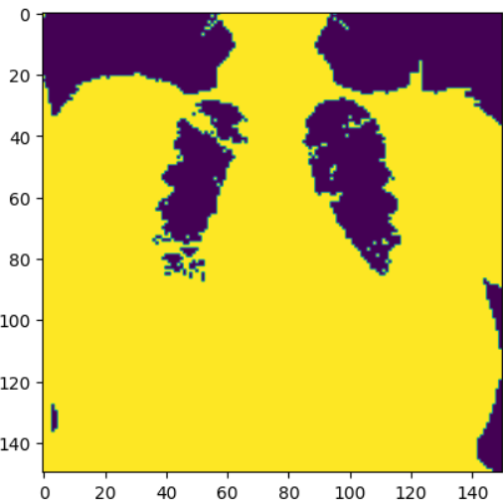

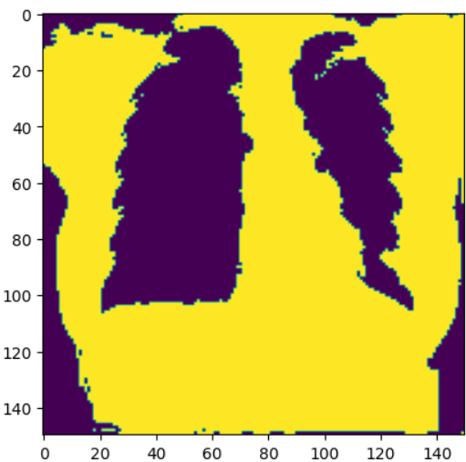
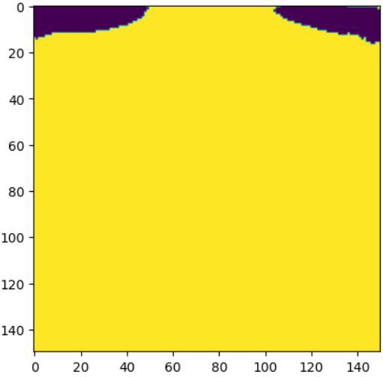
The Result :
Tuberculosis
Normal
Tuberculosis
Normal
Normal
Tuberculosis
Normal
Tuberculosis
Tuberculosis
Normal
6336 6336 (6336, 150, 150) (6336,)

Slide 16
Splitting
Dataset
02

Slide 17
The Dataset
80%
training
20%
testing
80%
training
20%
validation

Slide 18
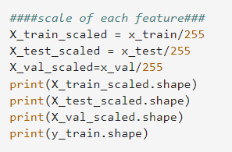

Scale Of Each Feature:

Slide 19
Training
Models

Slide 20
First CNN&KNN Model :

Slide 21
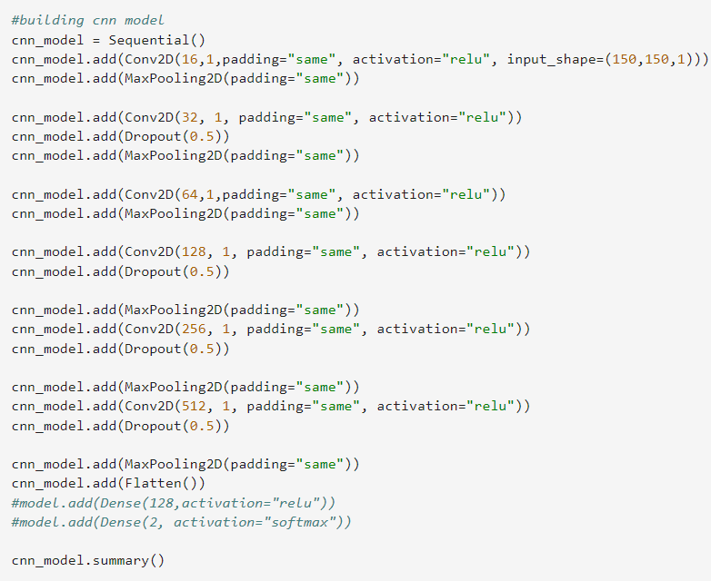
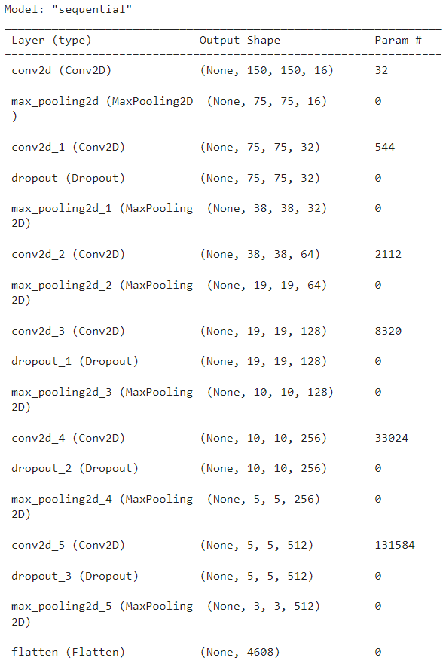

CNN Part

Slide 22
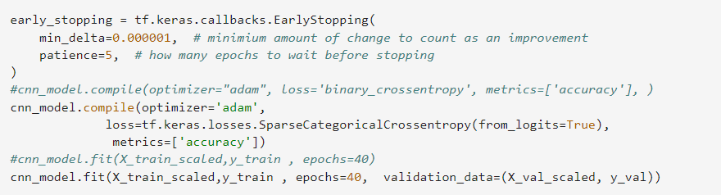
Training For 40 Epoch :

Slide 23
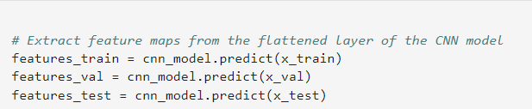

Feature Map :

Slide 24
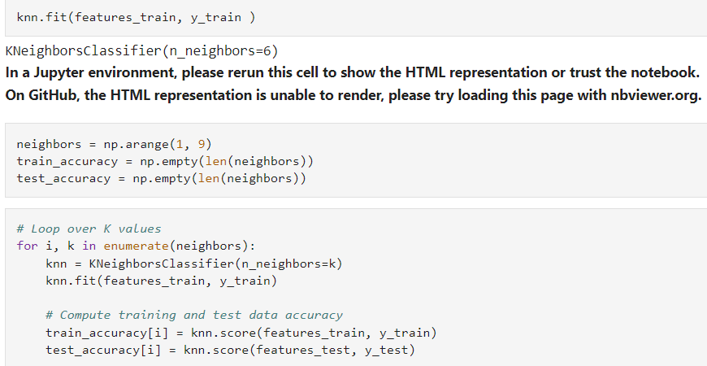
KNN Part

Slide 25
Testing
Model
CNN&KNN

Slide 26
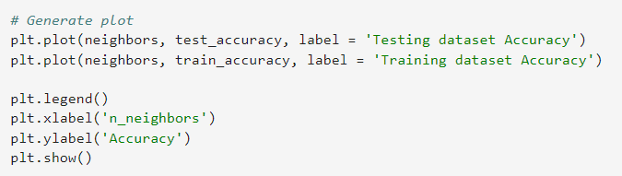
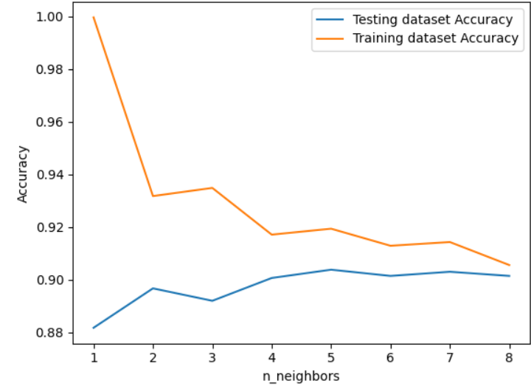
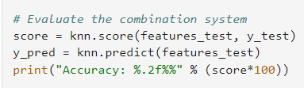
Accuracy: 90.14%

Slide 27
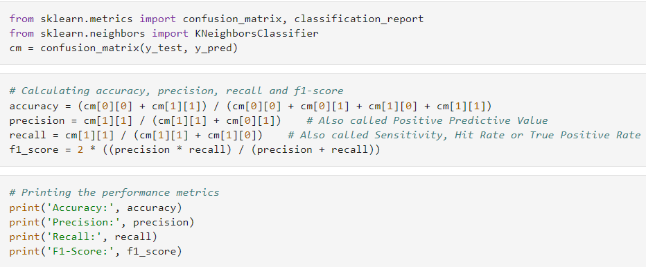


Slide 28
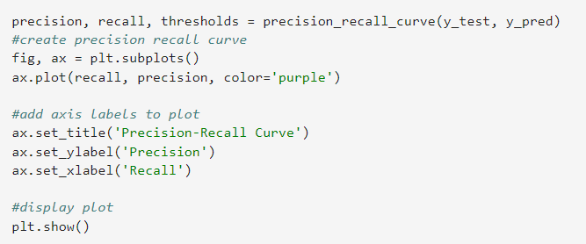
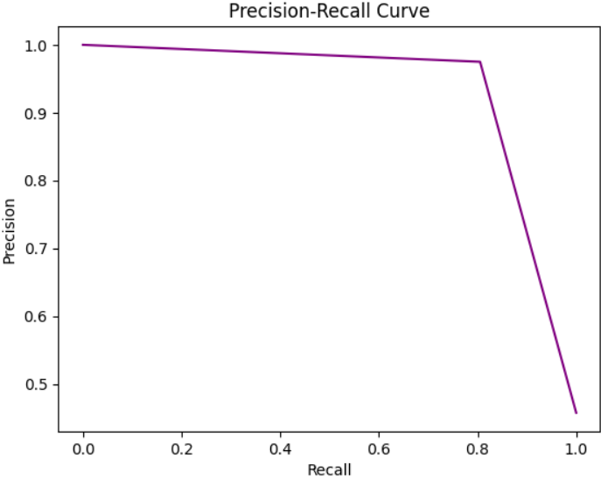
Precision Per Recall:

Slide 29
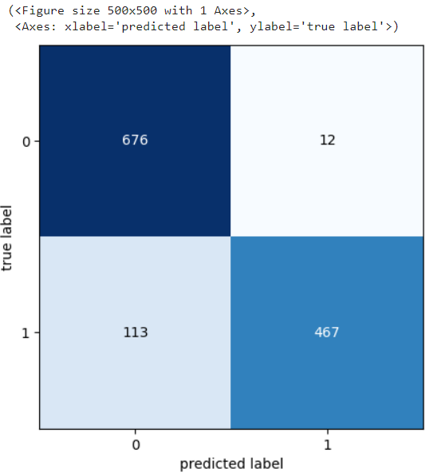
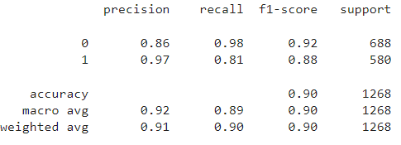
Model Report :

Slide 30
Second CNN Model :

Slide 31
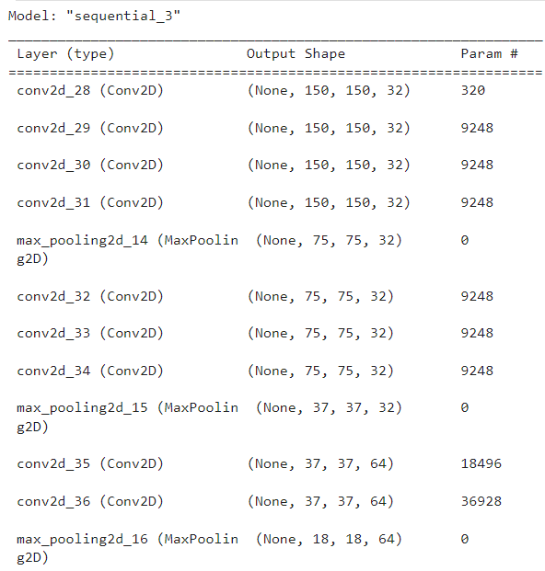
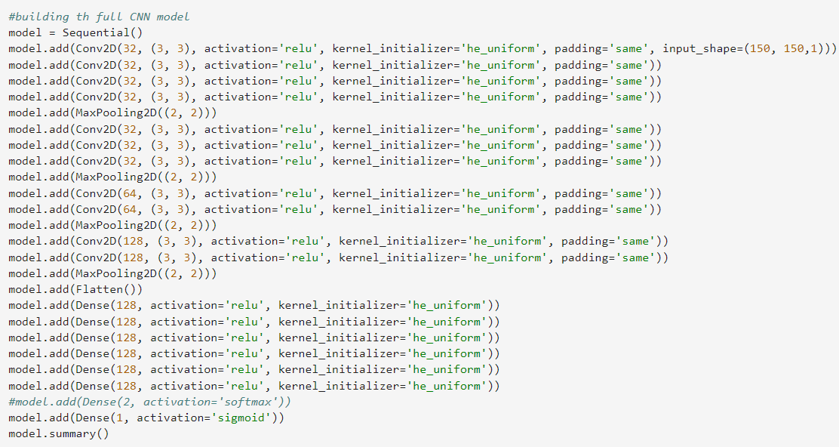
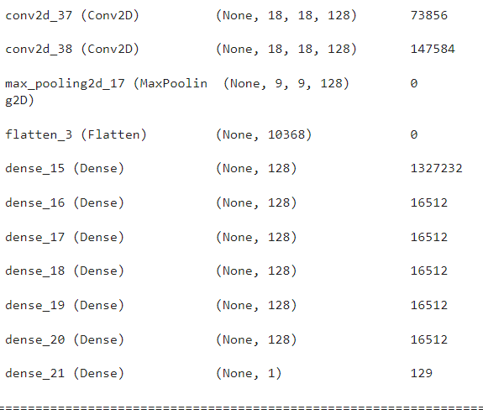


Slide 32
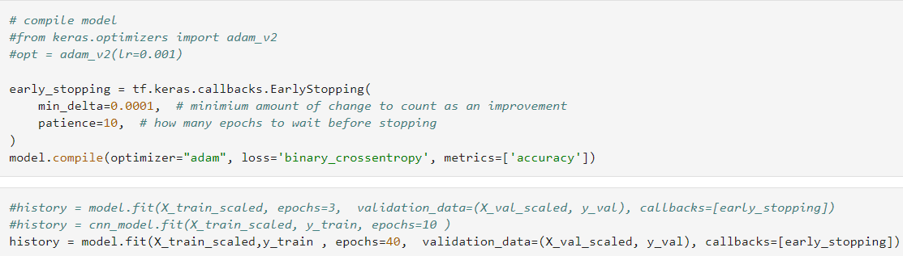
Training For 40 Epoch :

Slide 33
Testing
Model
CNN

Slide 34
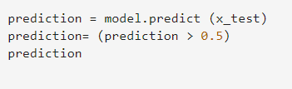
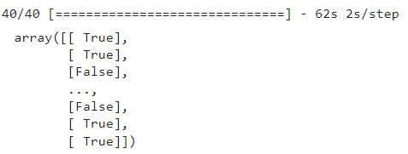
Prediction :

Slide 35
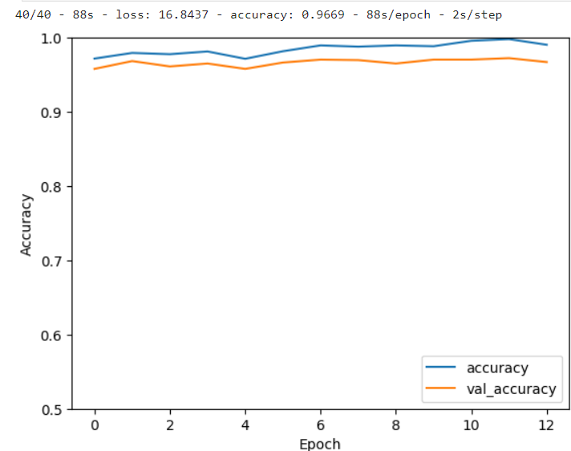
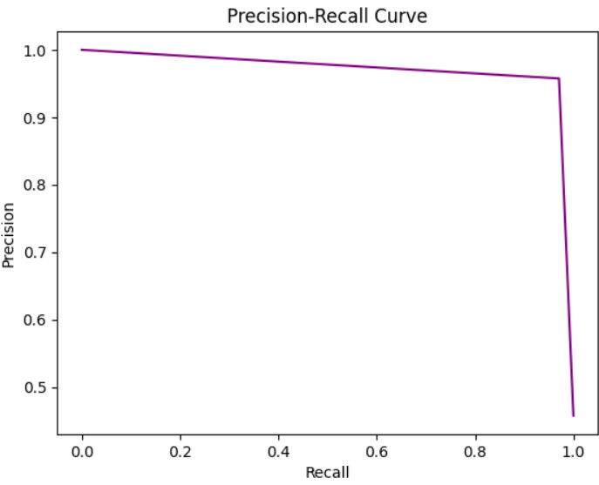
Lose Curve & Precision Per Recall:

Slide 36

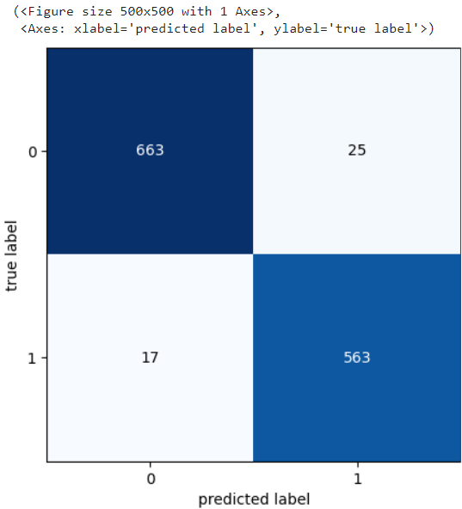

Model Report :
Accuracy: 97%

Slide 37
Conclusion
CNN
CNN-KNN

Slide 38
CNN on it's own gets better results than CNN-KNN model since KNN, output completely relies on nearest neighbors, which may or may not be good choice. Also it is sensitive to distance metrics. On the other hand, CNN extract the features from the input data. Which are very helpful for making analysis
Contrary to the research which is saying that CNN-KNN is better but I think that is because our dataset is much larger than the papers and we added more Dense layers to evaluate the model

Slide 39
THANKS!
Do you have any questions?
اميره اسامه محمد عبدالله
202000162
زينب محمد متولي علي
202000366
ريم اسماعيل حسن احمد
202000346
صفيه حمدي عبدالحميد
202000466
حبيبة ياسر سعيد محمد
202000262
صفاء محمود محمد
202000465

